Slide 1
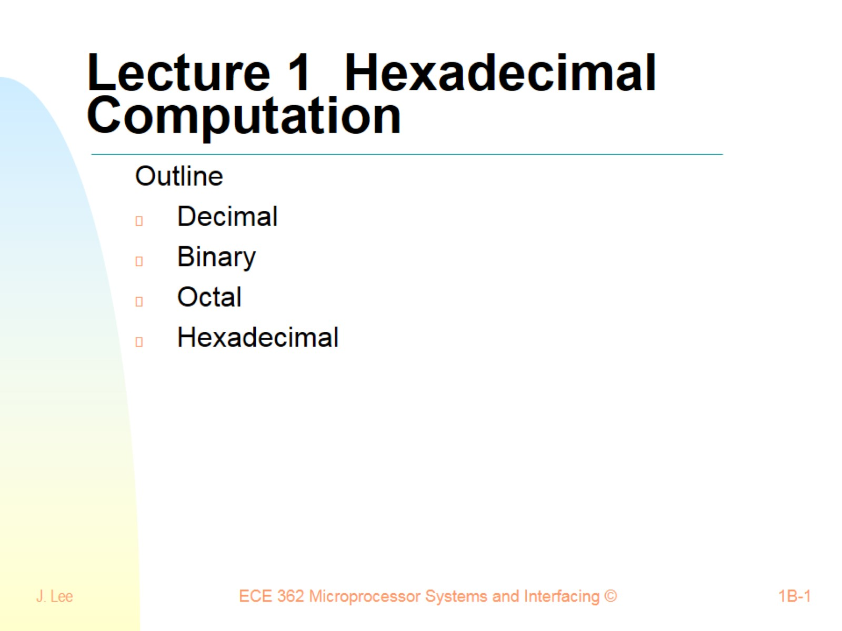
Lecture 1 Hexadecimal Computation

Slide 2
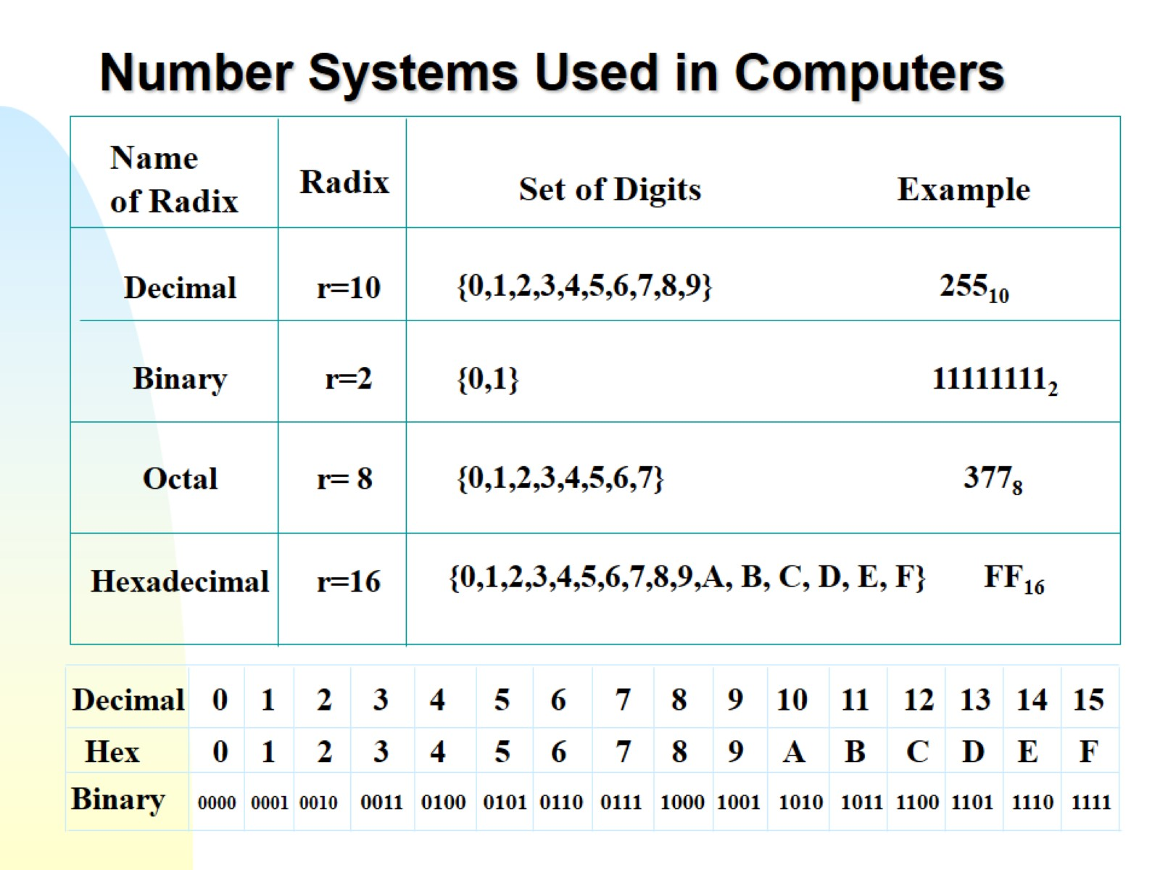
Number Systems Used in Computers

Slide 3
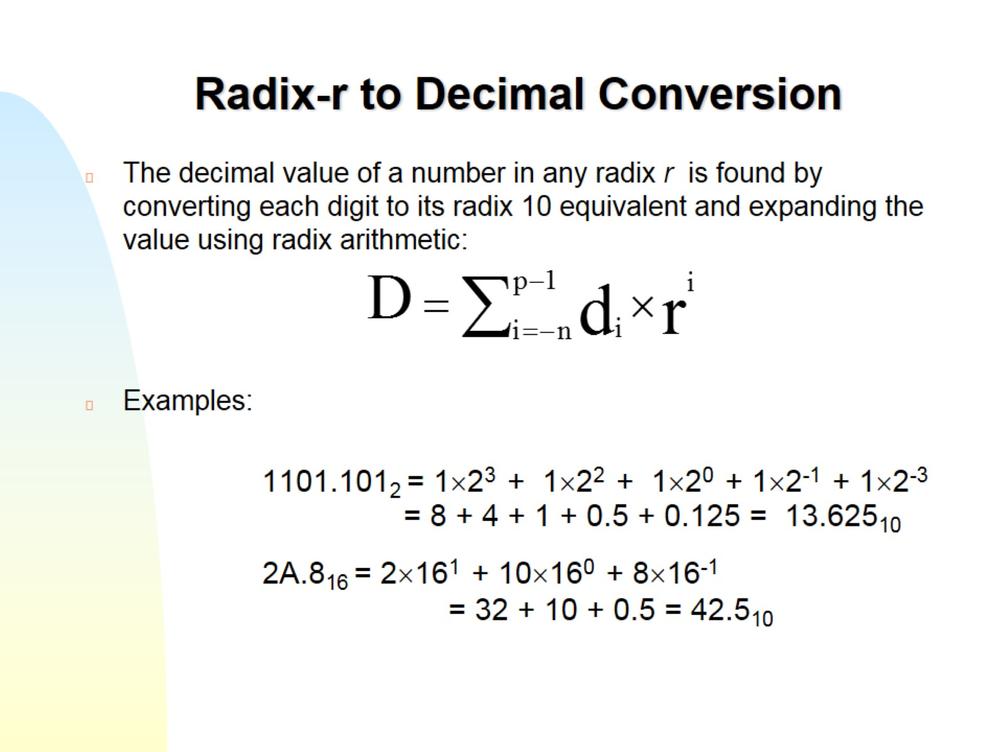
Radix-r to Decimal Conversion

Slide 4
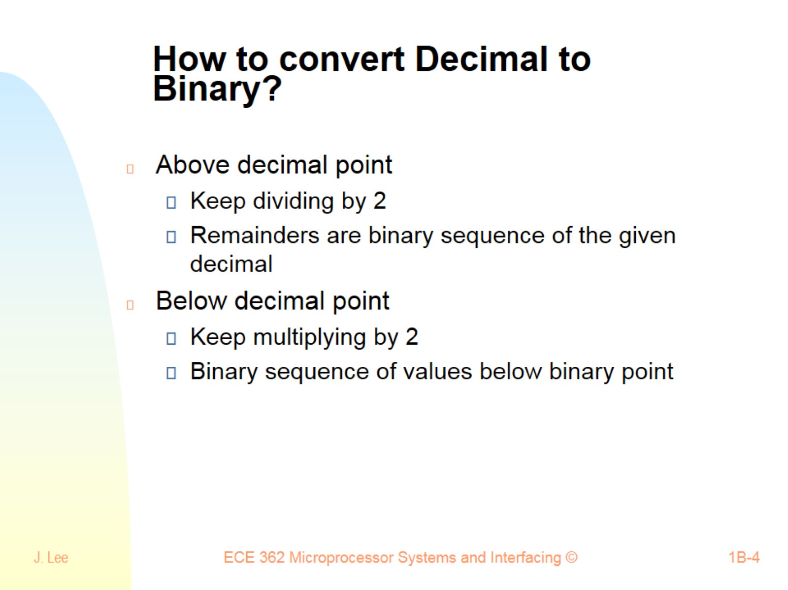
How to convert Decimal to Binary?

Slide 5
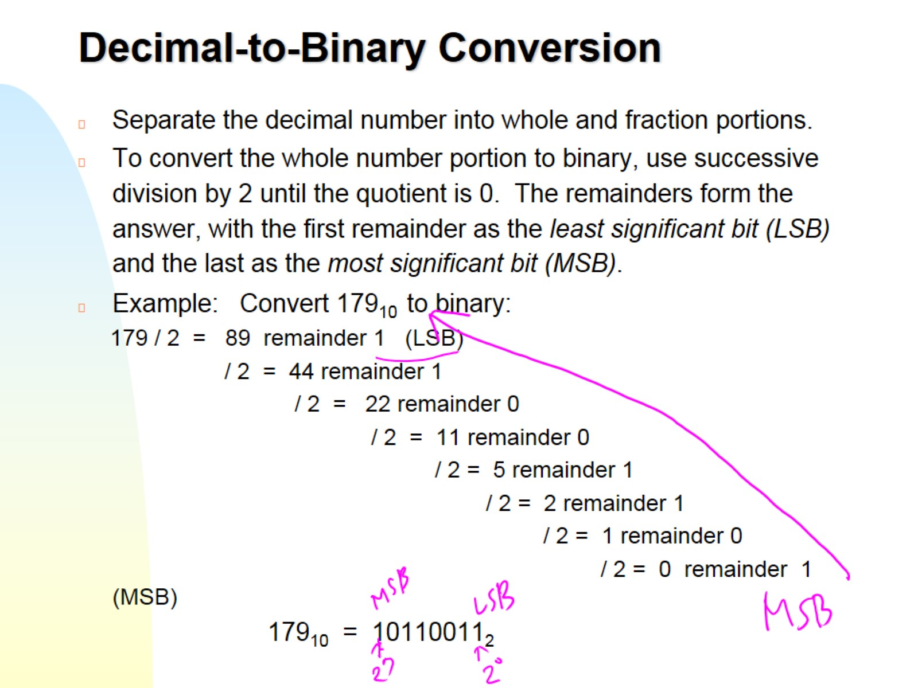
Decimal-to-Binary Conversion

Slide 6
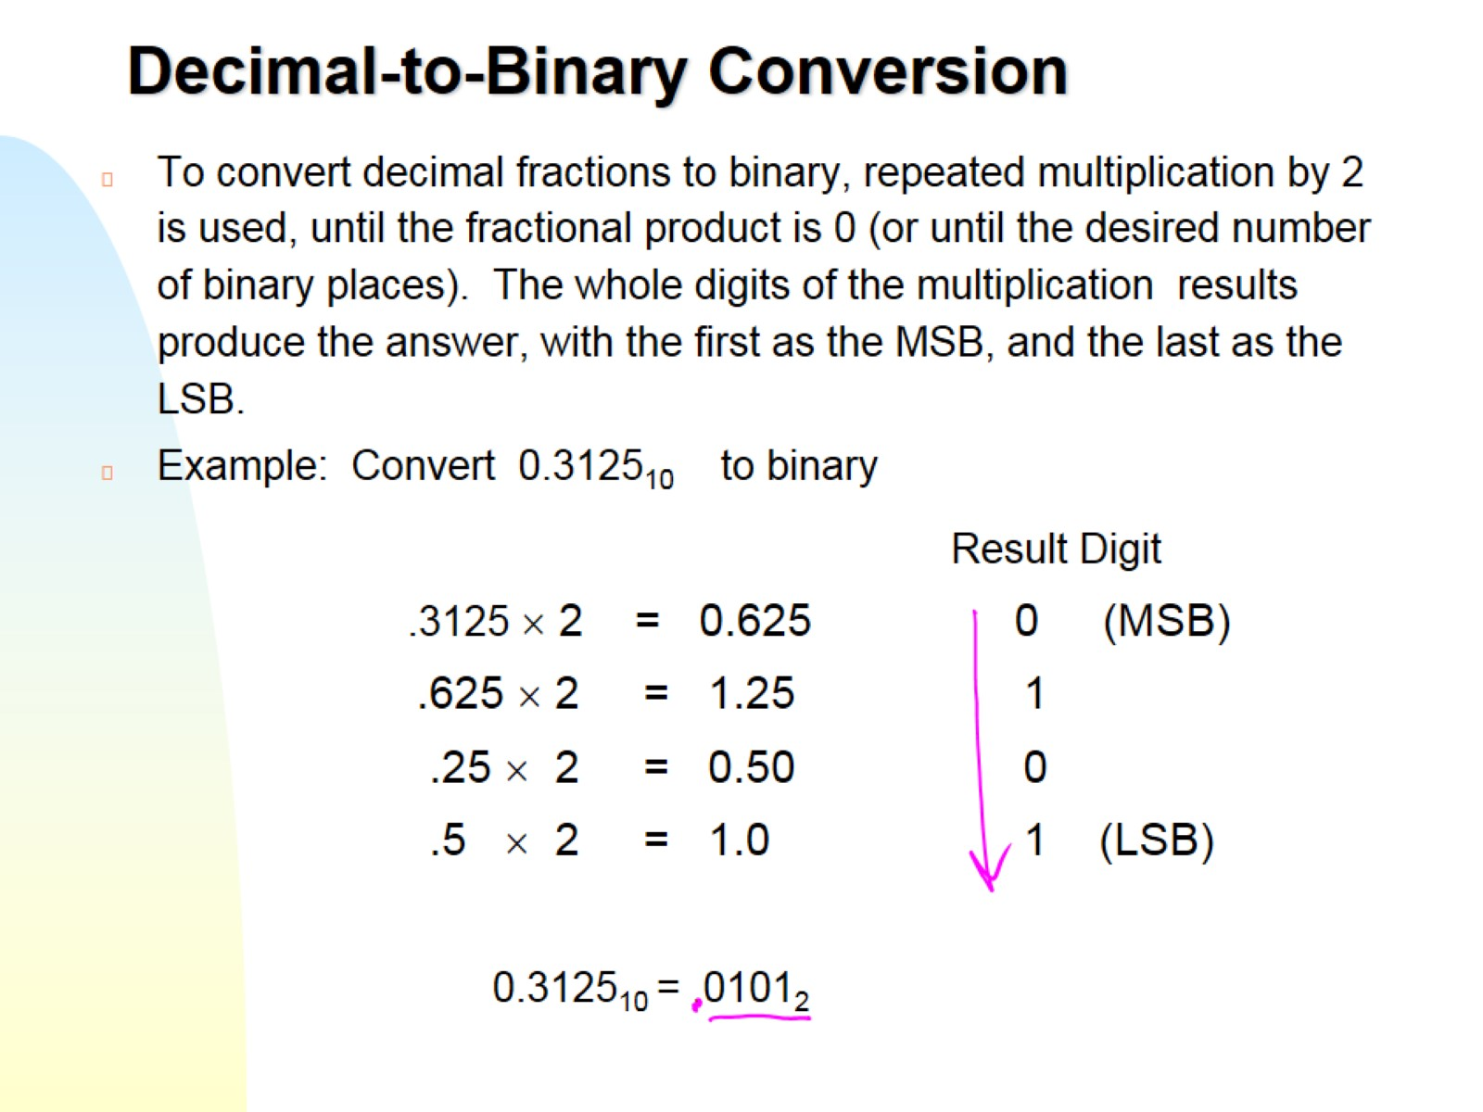
Decimal-to-Binary Conversion

Slide 7
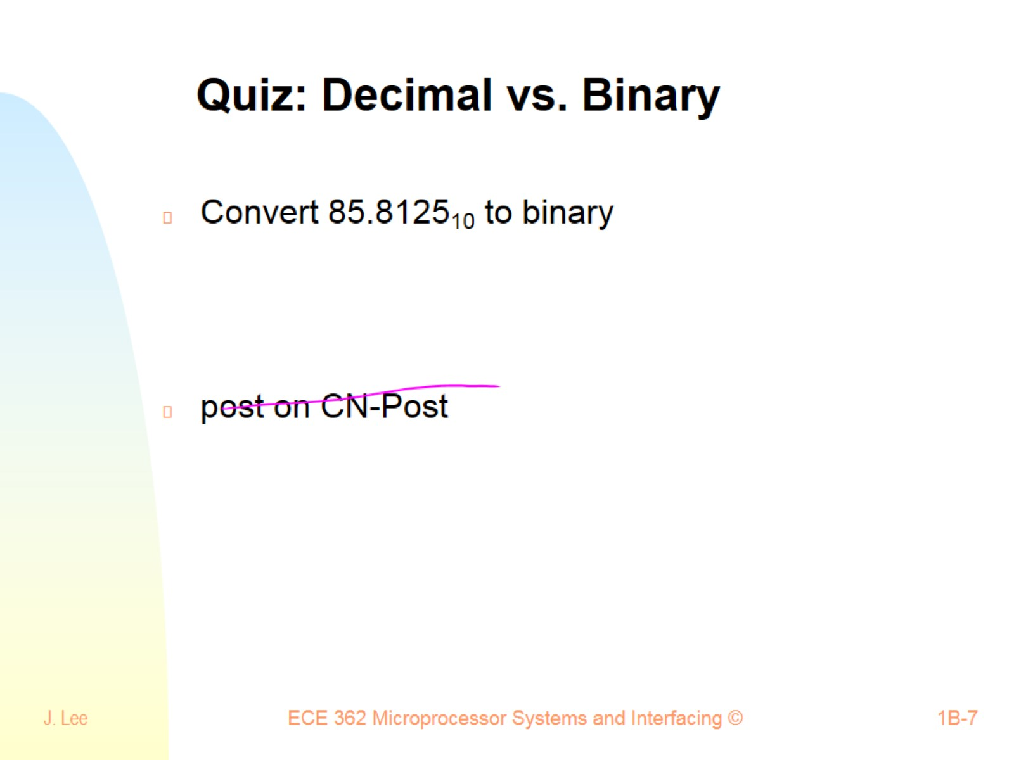
Quiz: Decimal vs. Binary

Slide 8
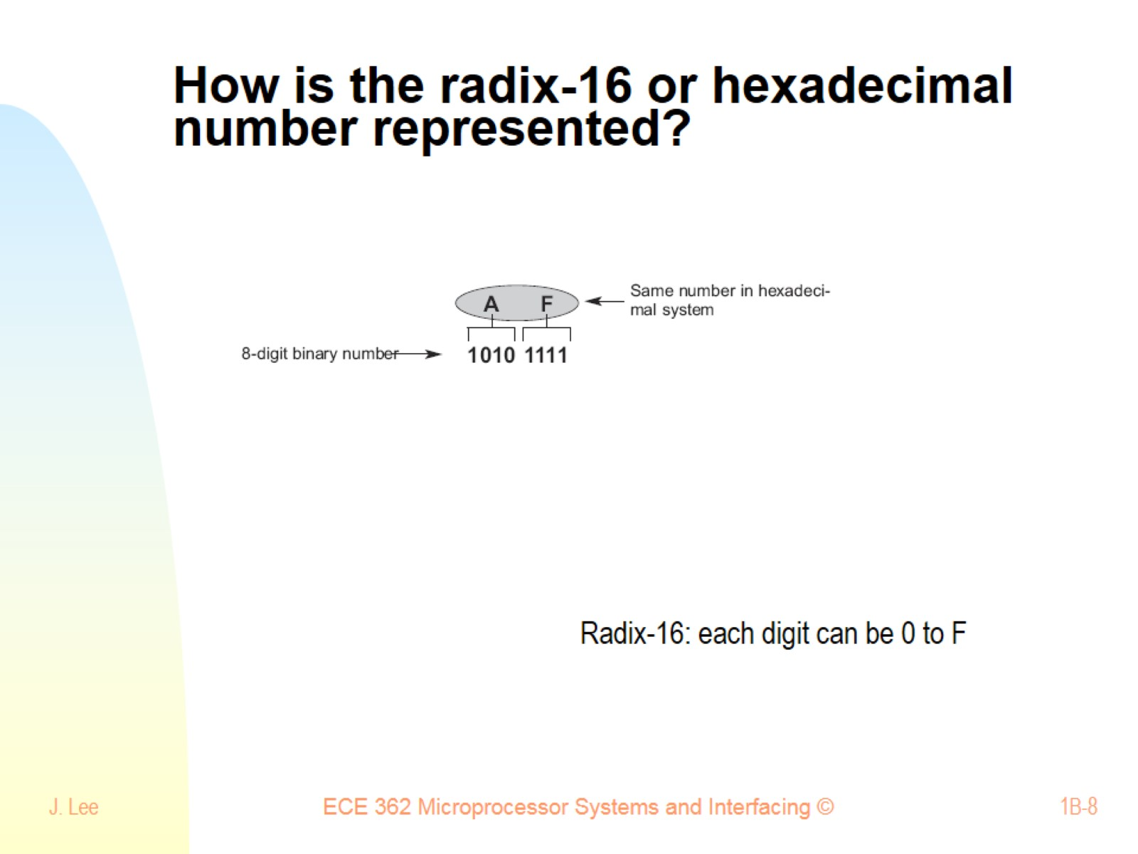
How is the radix-16 or hexadecimal number represented?

Slide 9
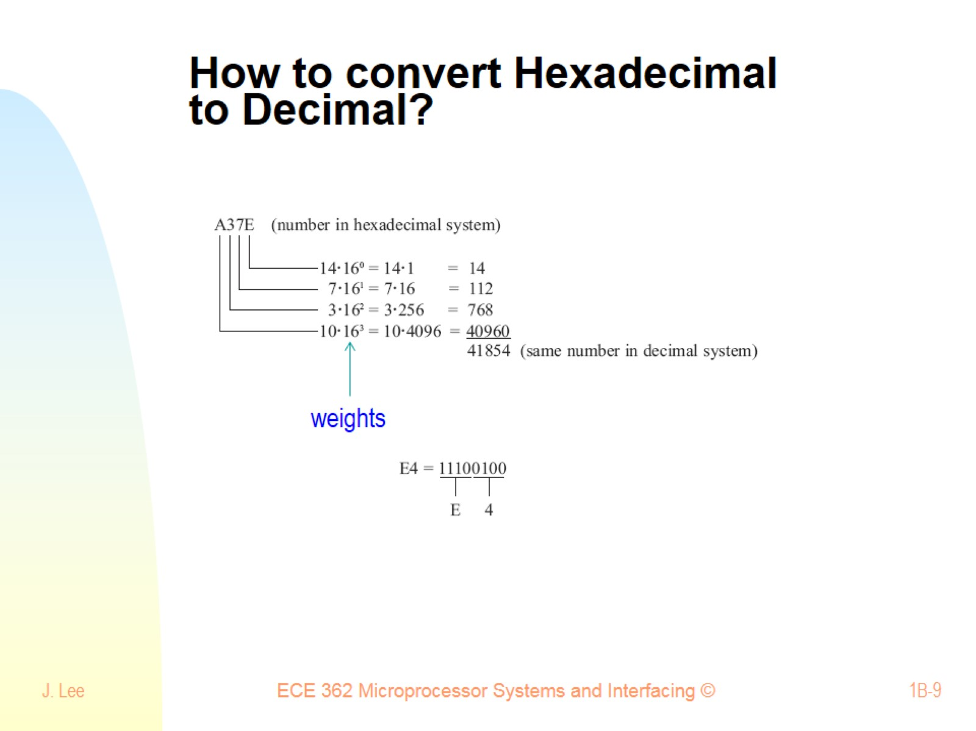
How to convert Hexadecimal to Decimal?

Slide 10
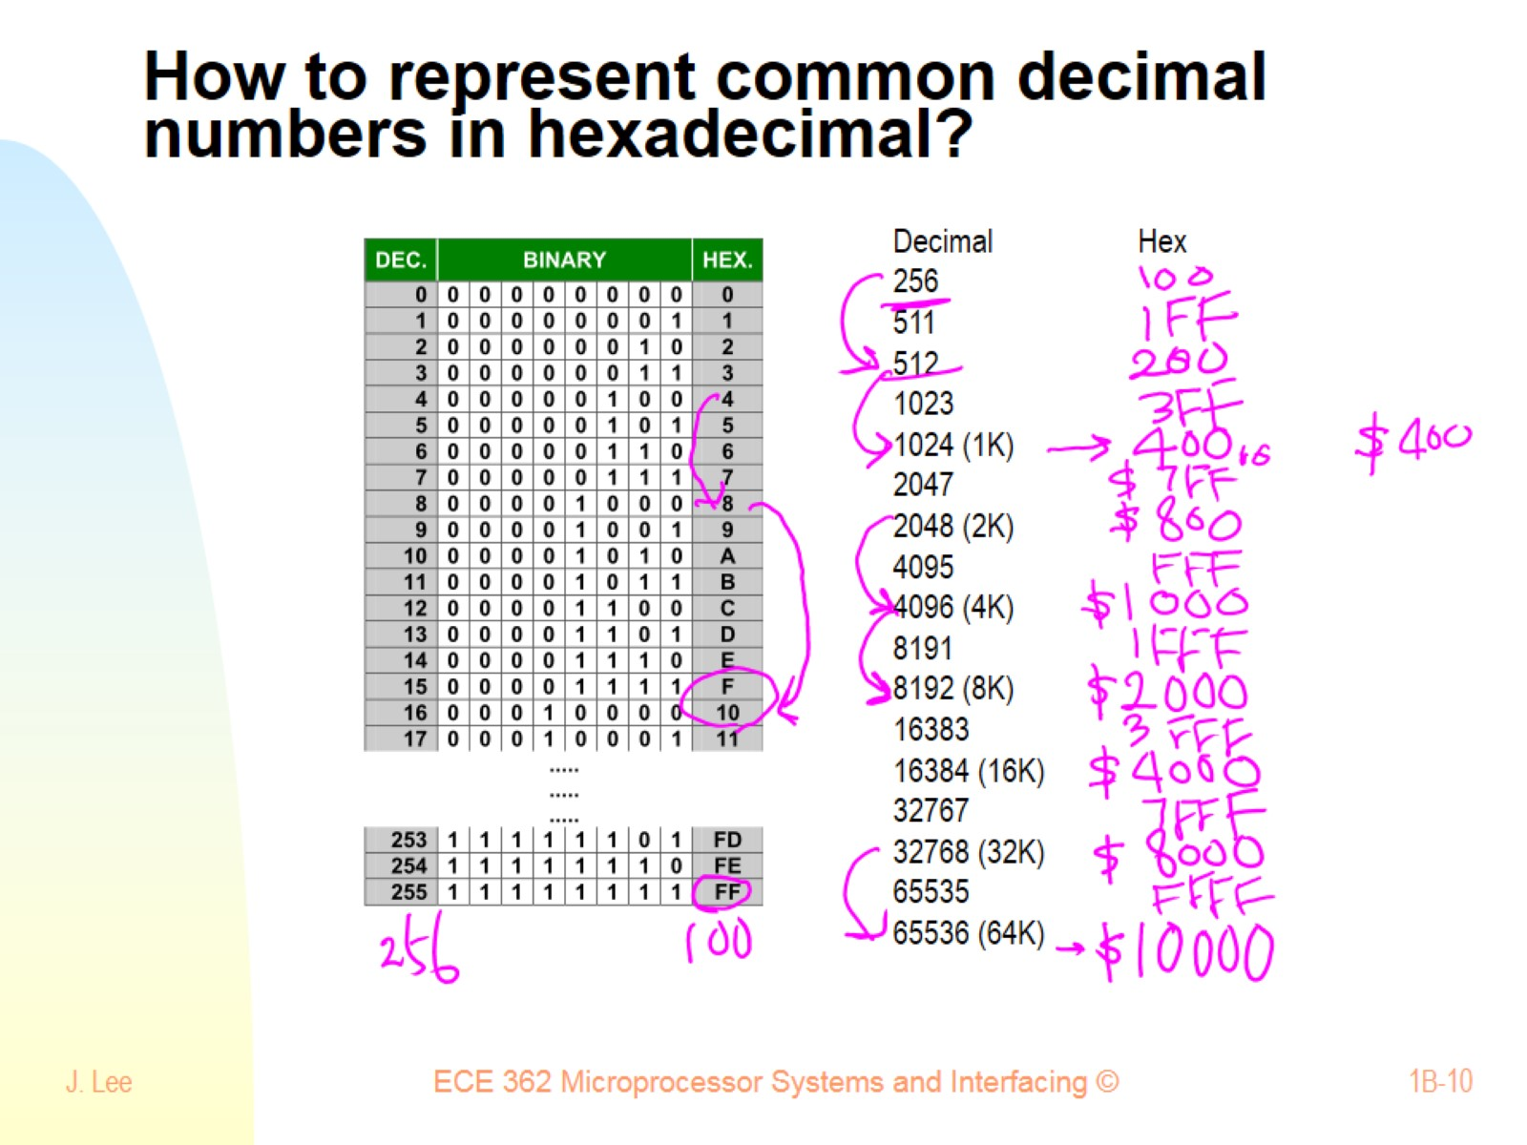
How to represent common decimal numbers in hexadecimal?

Slide 11
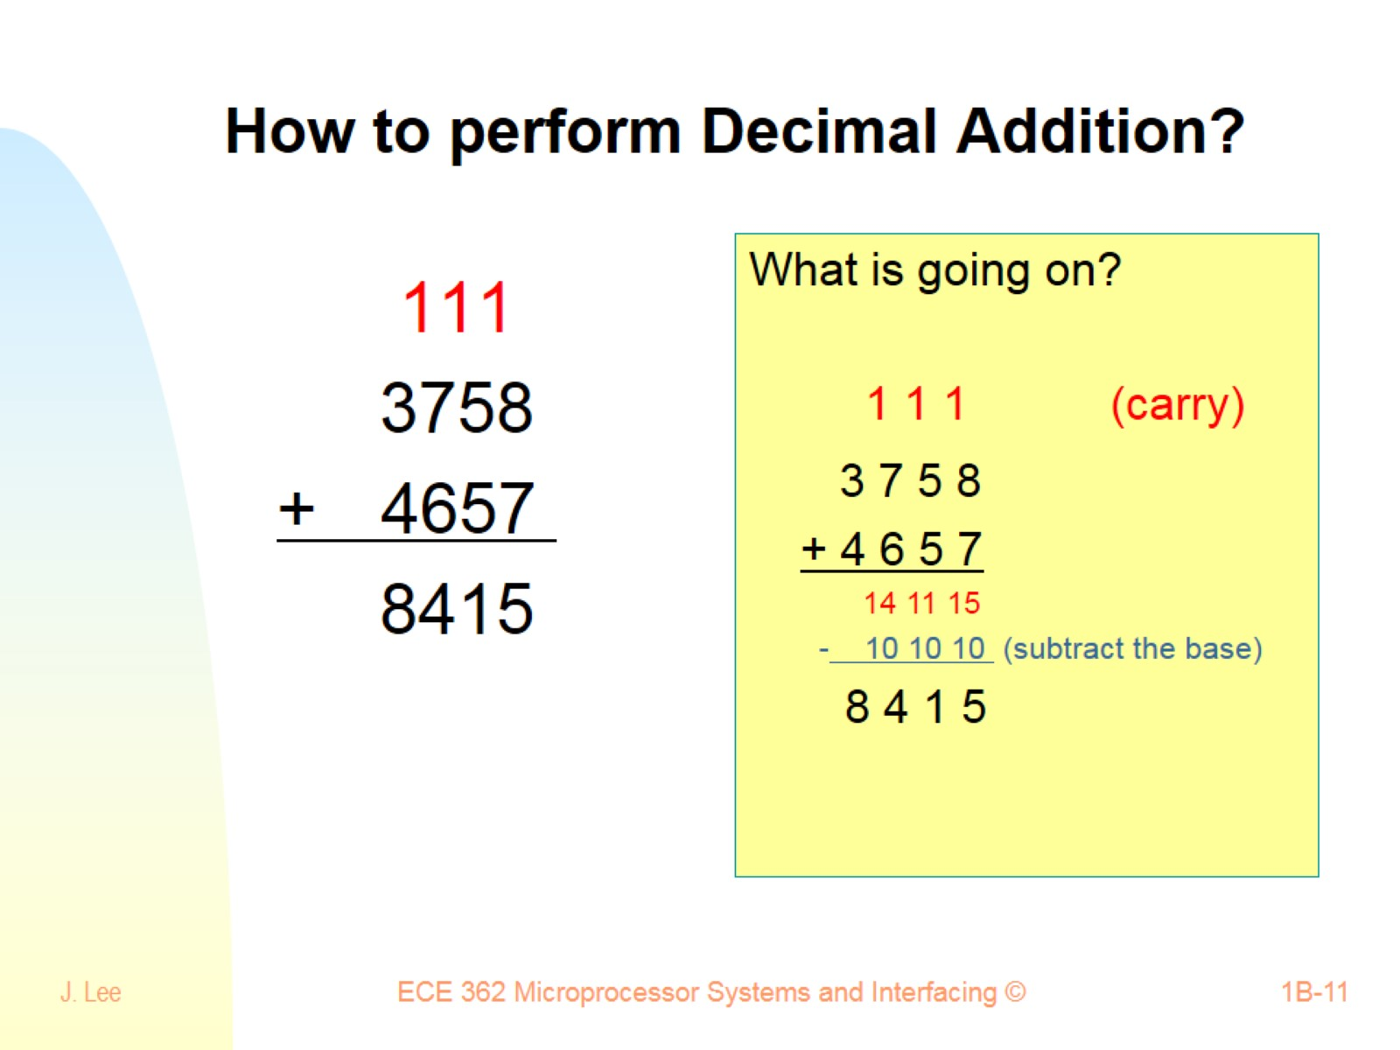
How to perform Decimal Addition?

Slide 12
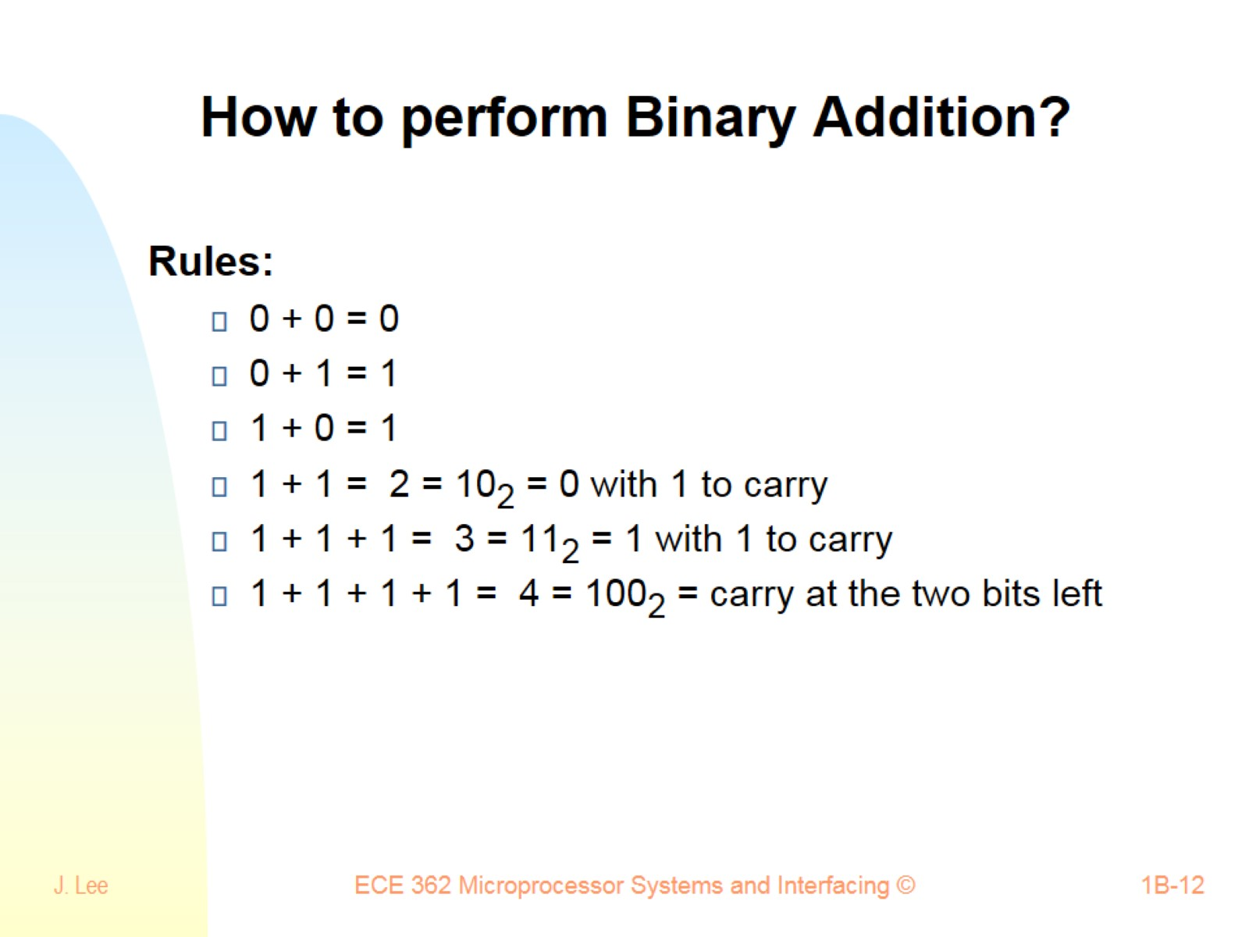
How to perform Binary Addition?

Slide 13
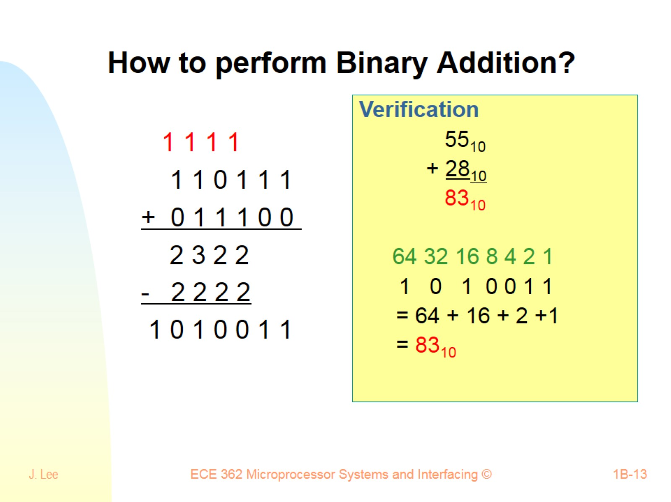
How to perform Binary Addition?

Slide 14
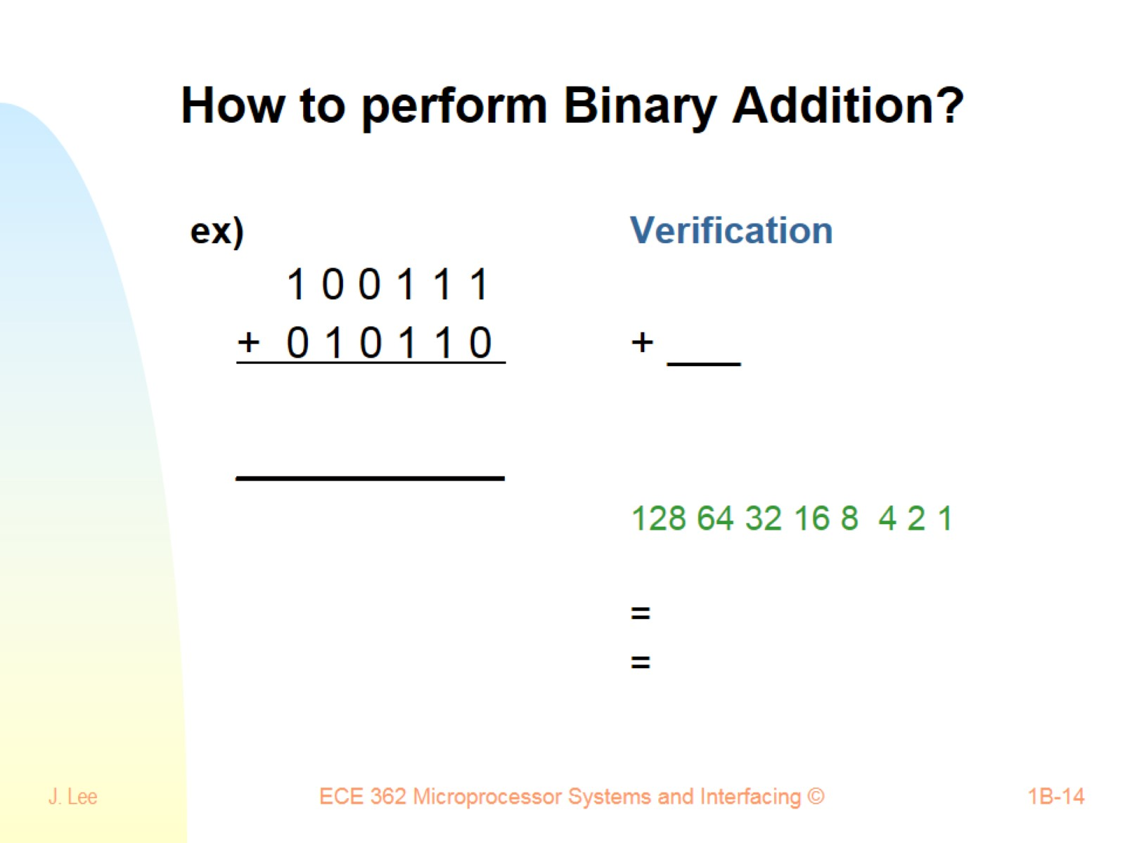
How to perform Binary Addition?

Slide 15
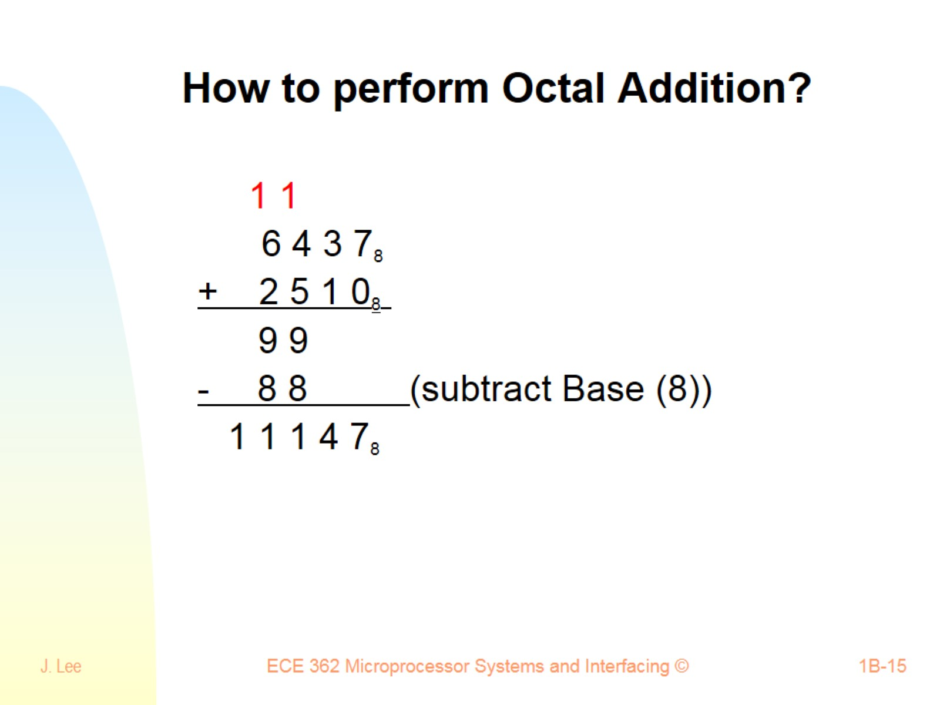
How to perform Octal Addition?

Slide 16
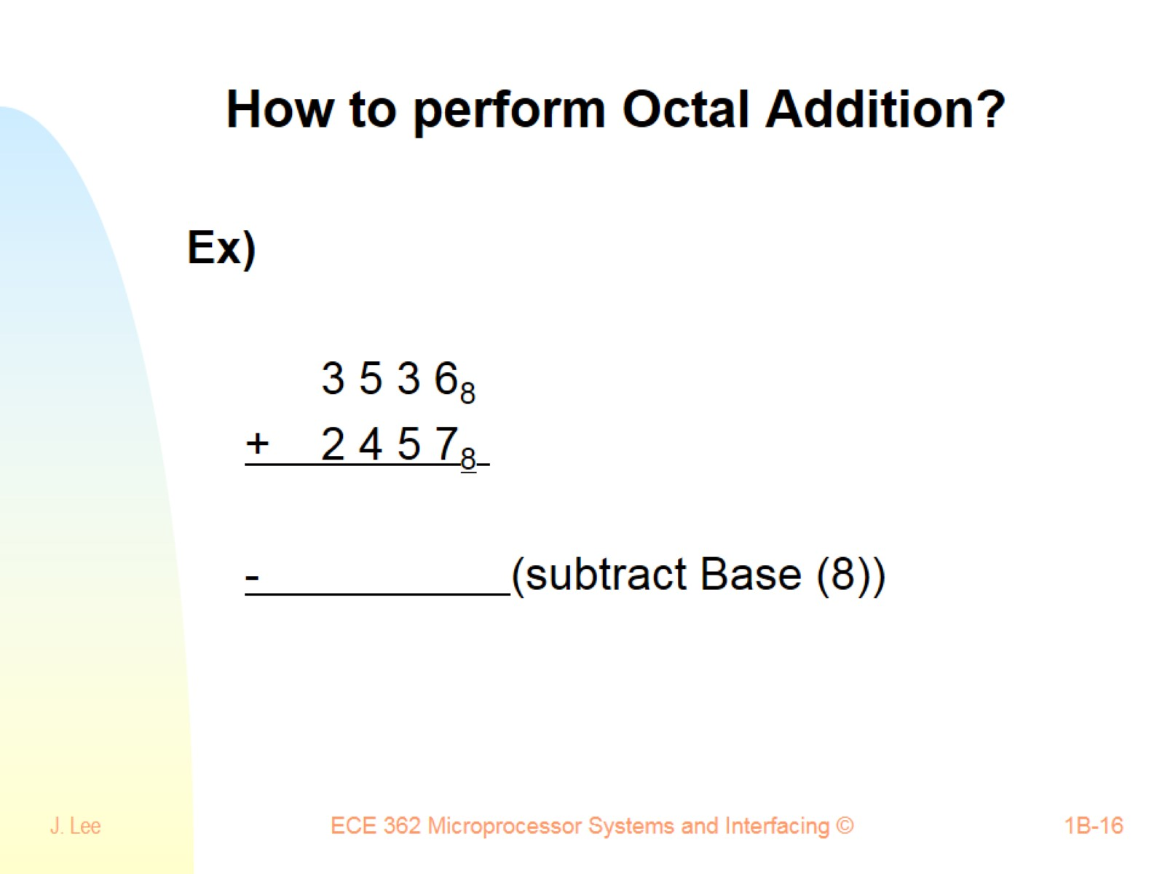
How to perform Octal Addition?

Slide 17
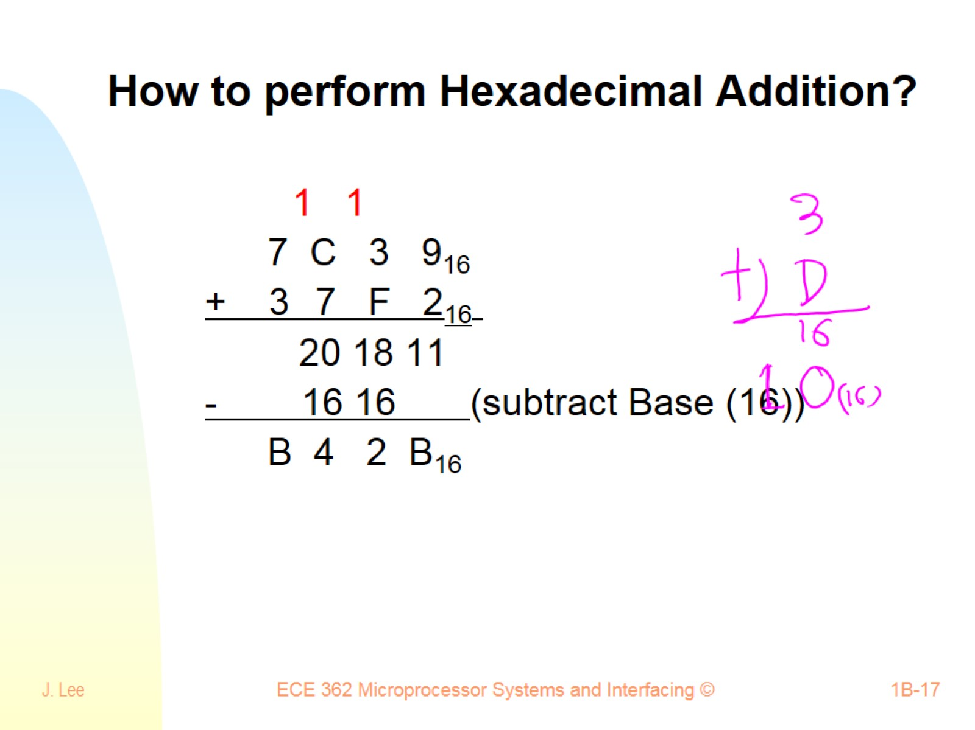
How to perform Hexadecimal Addition?

Slide 18
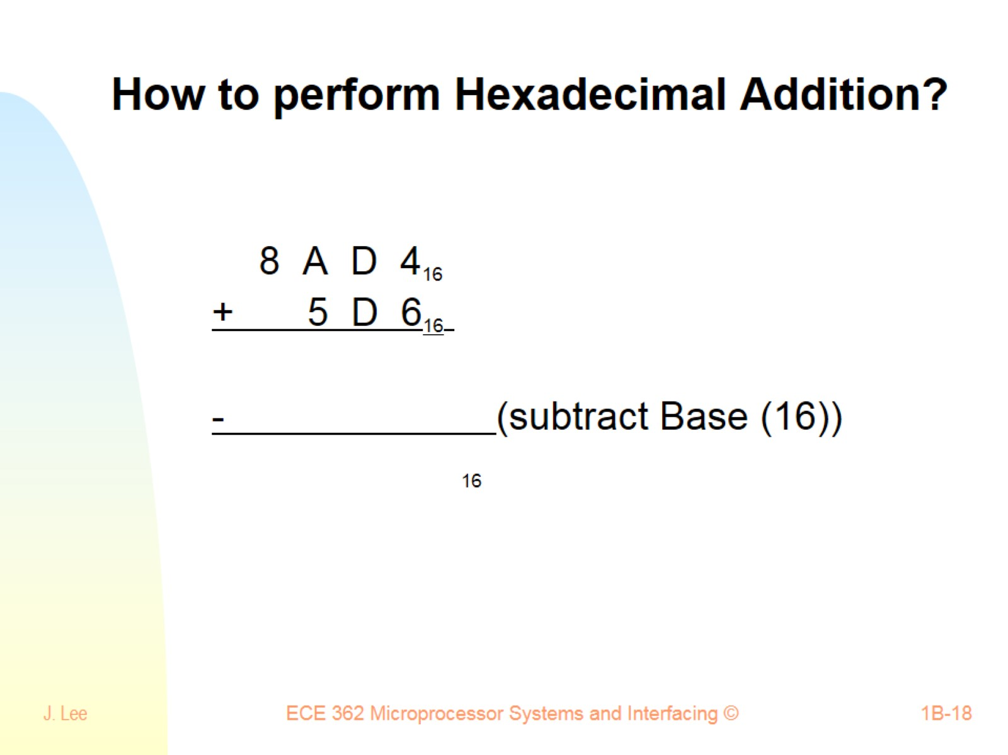
How to perform Hexadecimal Addition?

Slide 19
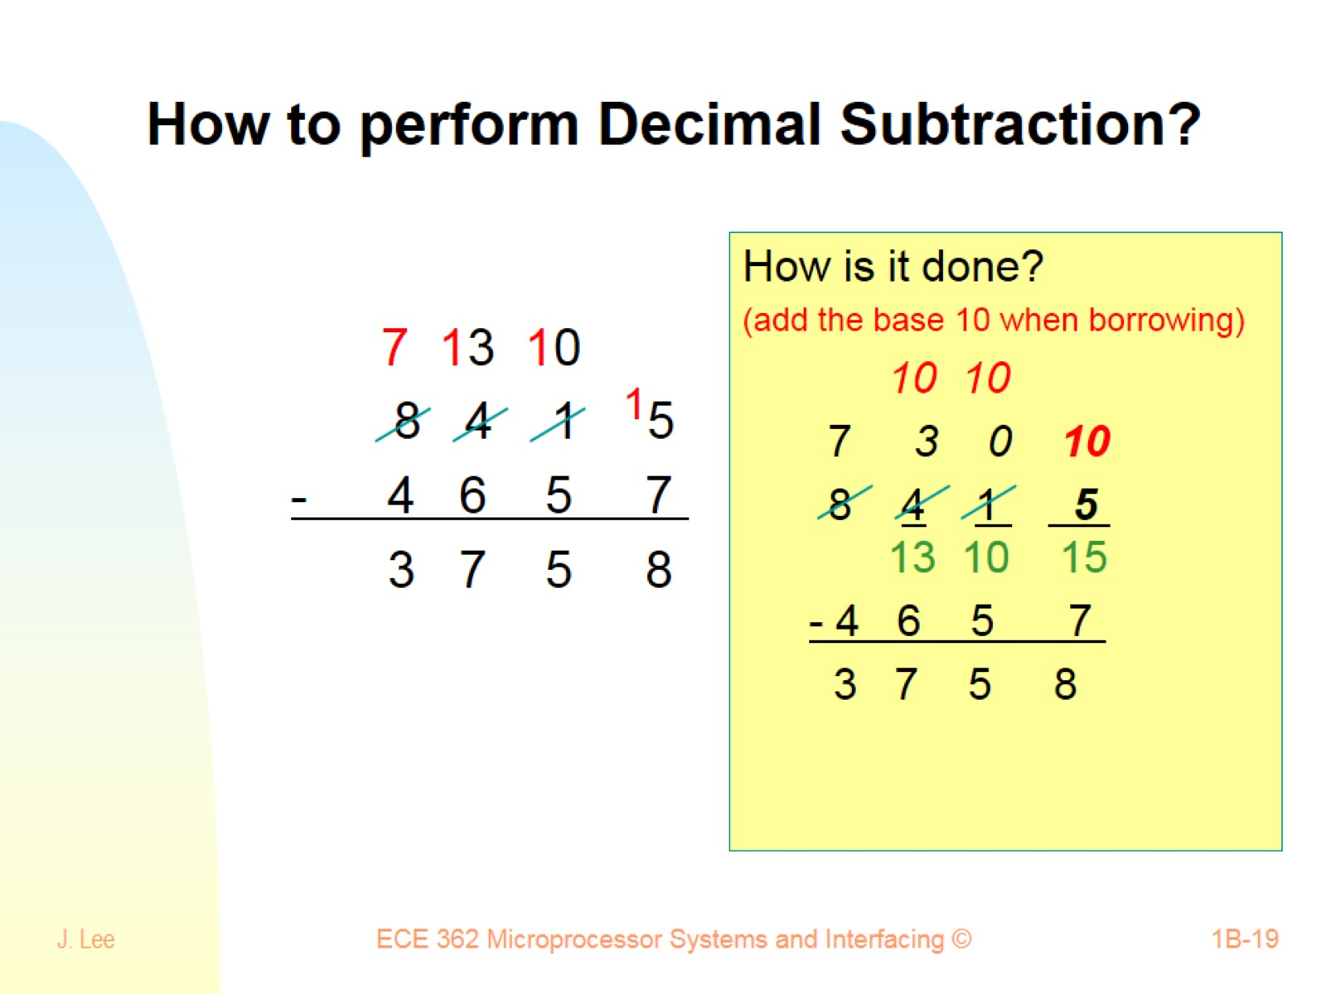
How to perform Decimal Subtraction?

Slide 20
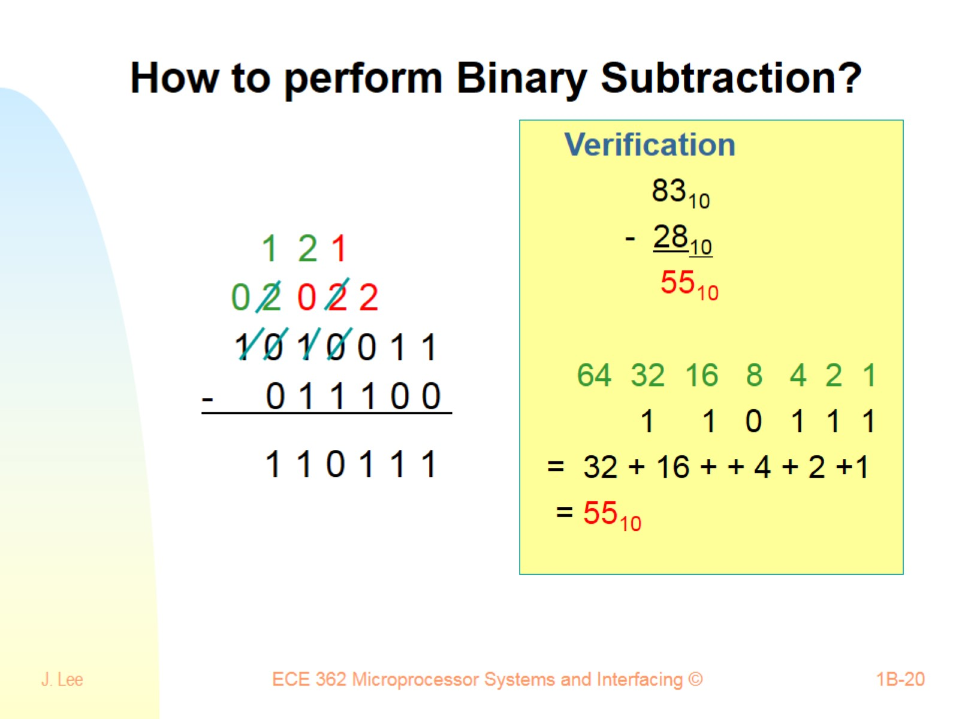
How to perform Binary Subtraction?

Slide 21
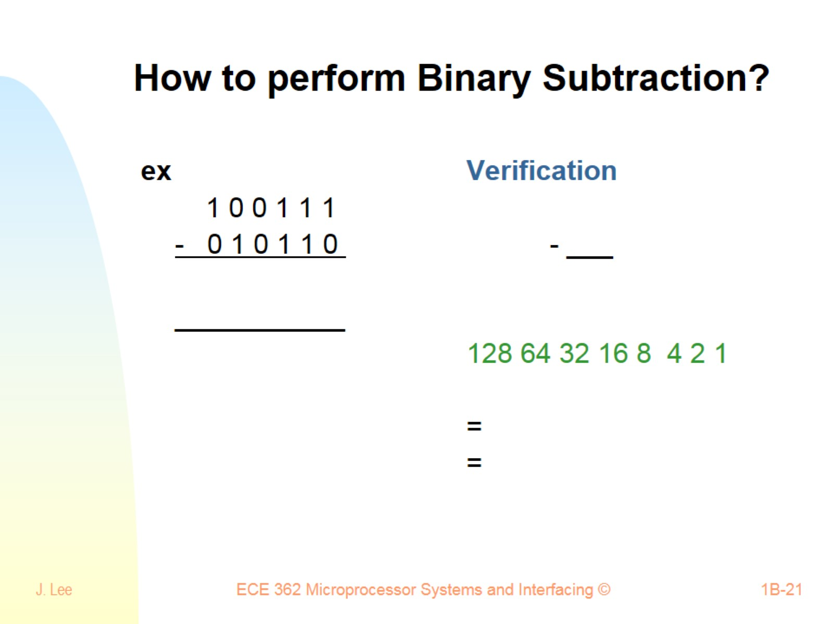
How to perform Binary Subtraction?

Slide 22
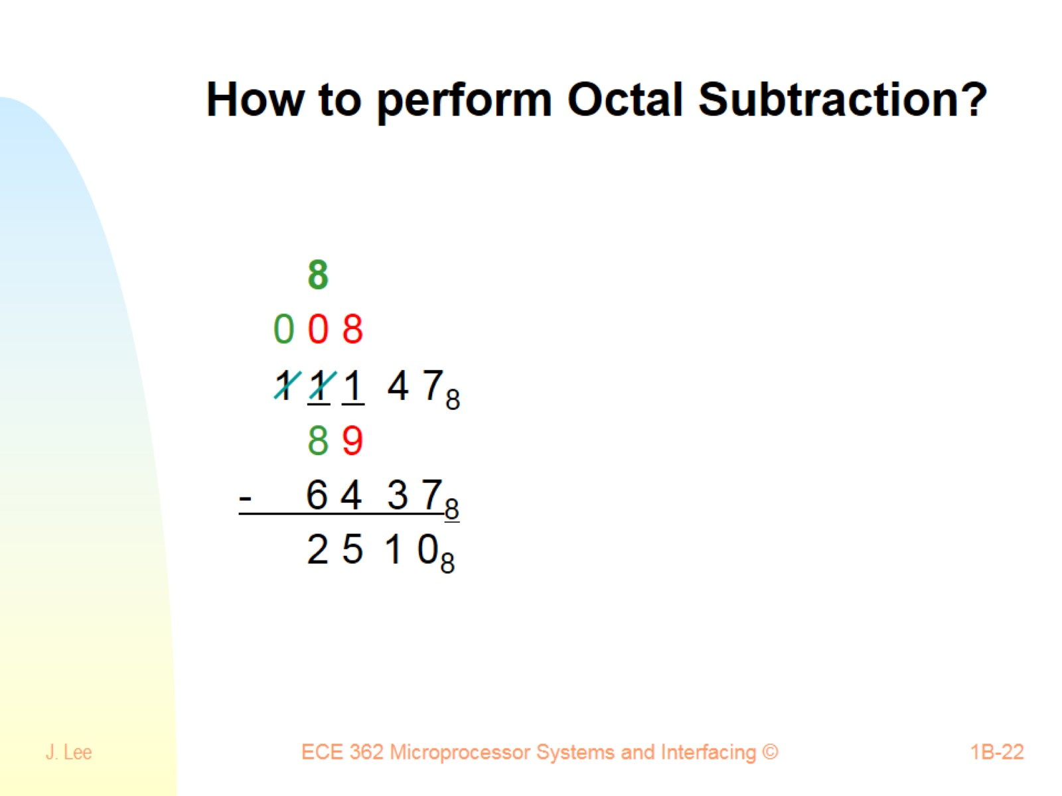
How to perform Octal Subtraction?

Slide 23
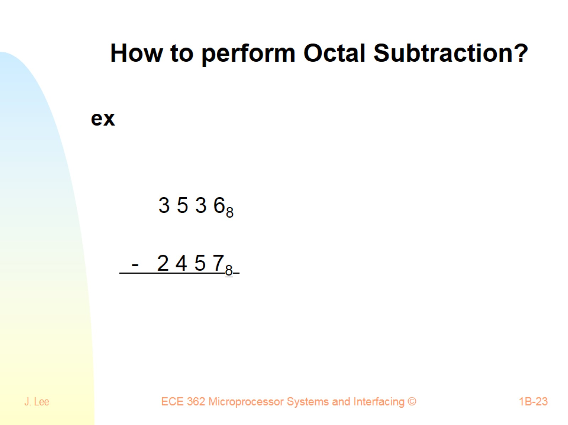
How to perform Octal Subtraction?

Slide 24
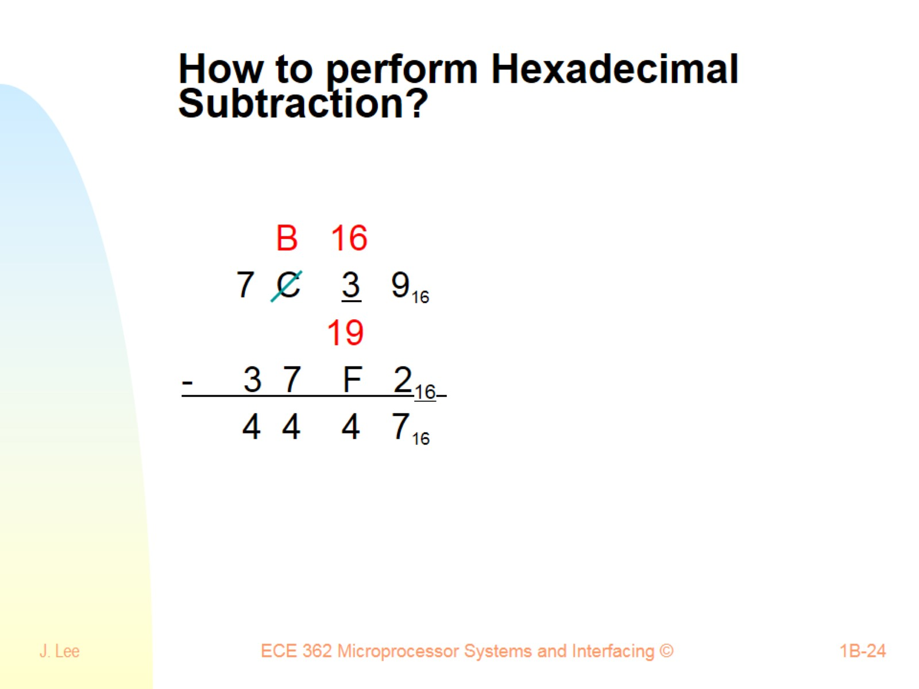
How to perform Hexadecimal Subtraction?

Slide 25
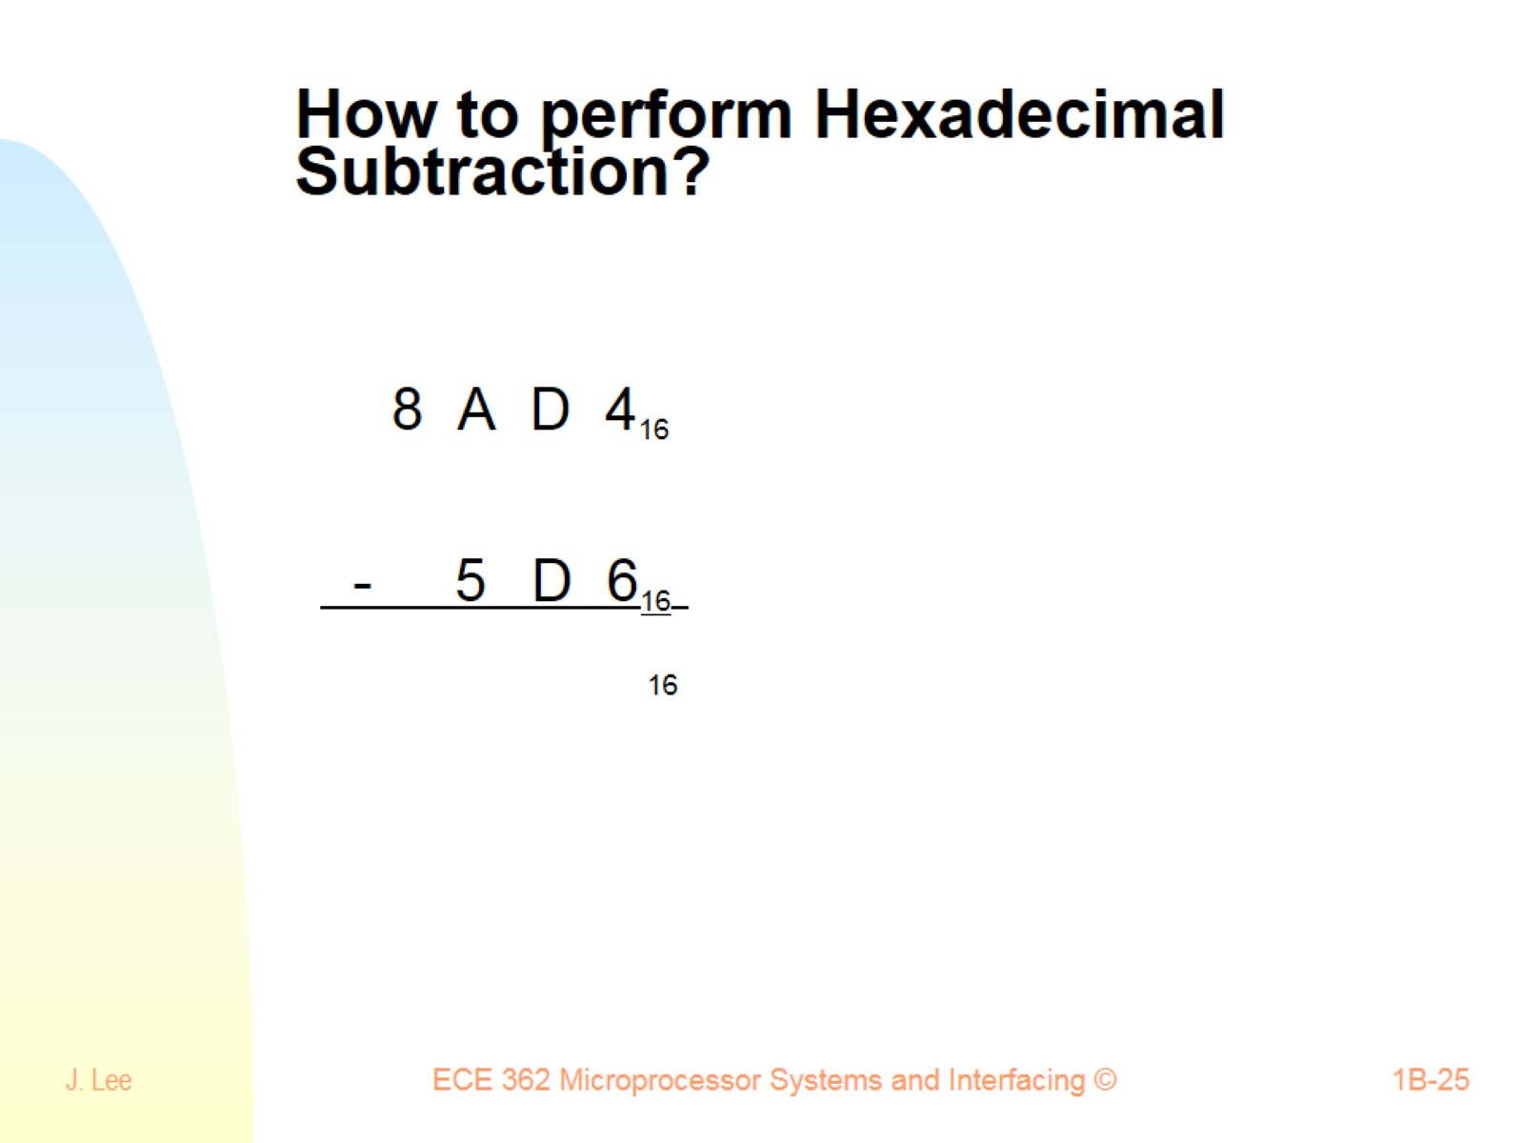
How to perform Hexadecimal Subtraction?

